Slide 1
Introduction to Strings and its Operations L1 and L2

Slide 2
In Python, string is a contiguous sequence of Unicode Characters.
In the computer, everything is stored in binary format, i.e. 0(zero)'s and 1(one)'s. The elementary storage unit is called a bit, which can store either zero or one.
To represent various letters, symbols and numbers in different languages, we need 16 bits.
Each different sequence of the 16 bits represents one symbol like A or B or C etc.
This system of representing the various existing letters, numbers and symbols (+ _ - $ % @ ! etc) is called UNICODE.
Strings are represented with prefixing and suffixing the characters with quotation marks (either single quotes (') or double quotes (")).
An individual character within a string is accessed using an index. The index should always be an integer (positive or negative).
The index starts from 0 to n-1, where n is the number of characters in the string.
The contents of the string cannot be changed after it is created.
The return value of the Python input() statement is, by default, a string.
A string of length 1 can be treated as a character.

Slide 3
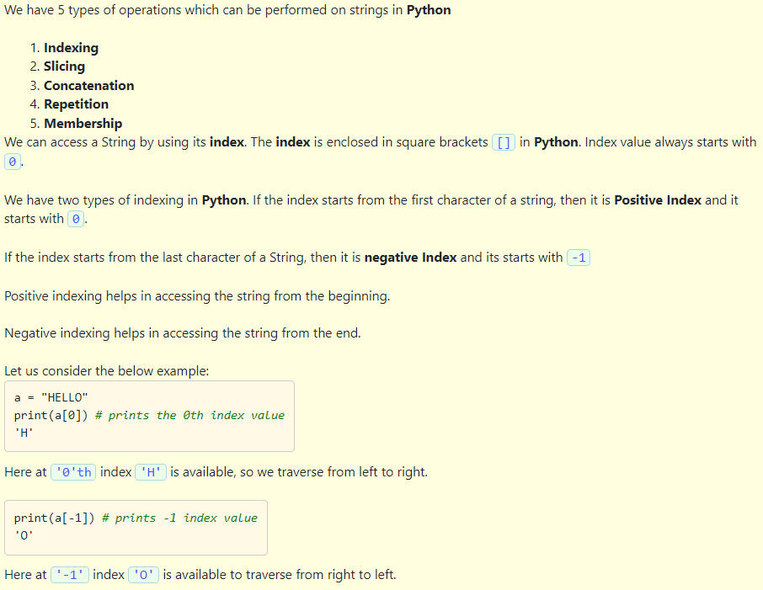
String operations

Slide 4
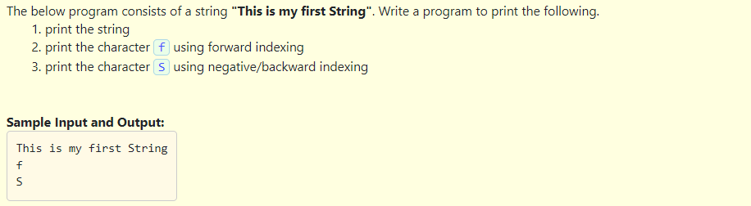
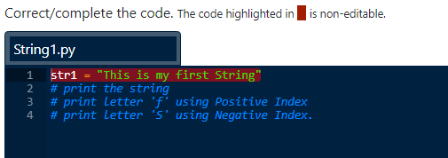

Slide 5
Solution:
str1 = "This is my first String"
print(str1)
print(str1[11])
print(str1[-6])

Slide 6
Python provides many ways to extract a part of a string using a concept called Slicing.
Slicing makes it possible to access parts (segments) of the string by providing a startIndex and an endIndex.
The syntax for using the slice operation on a string is:
[startIndex : endIndex : step]
For example, in the below code: slice[start : stop : step] operator extracts sub string from the string.
A segment of a string is called a slice. The indexes start and stop should be valid.
Step is the increment or decrement .
A positive step will travel left to right and increments the index by step.
A negative step will travel from right to left and decrements the index by step.
If we are not providing starting of index position in Slice [ ] operator then interpreter takes starting index zero(0) as default.
If end index is not specified for slice [ ] operator then Interpreter takes the end of String as default stop index.

Slide 7
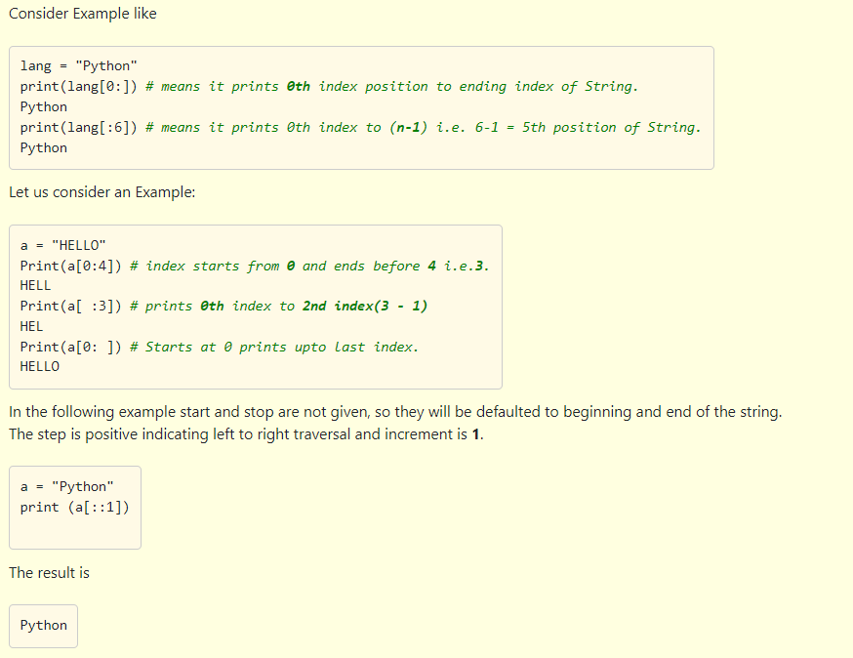

Slide 8
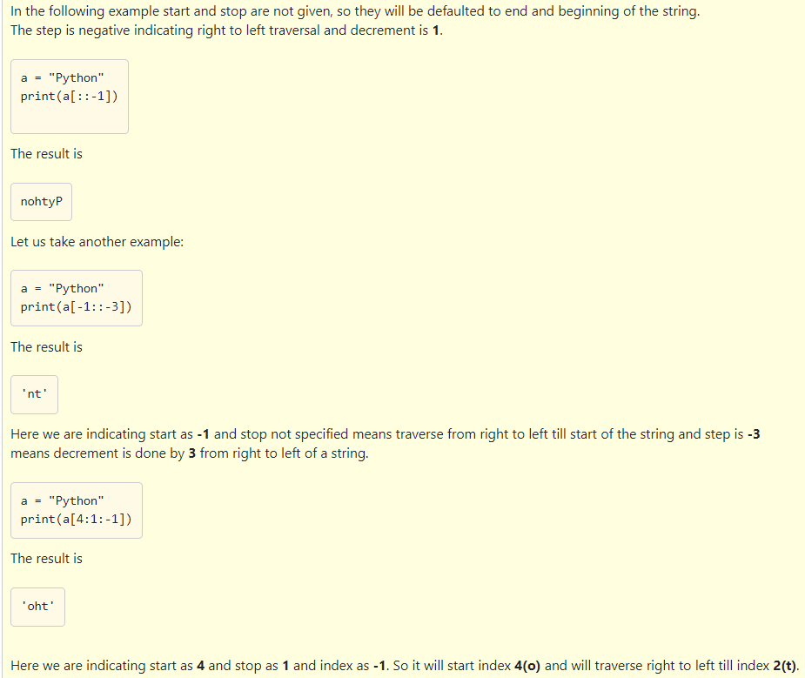

Slide 9
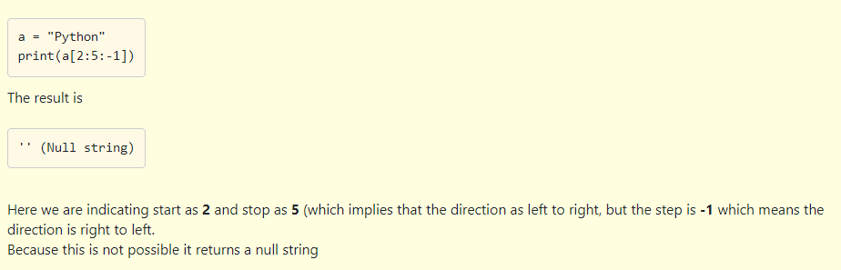

Slide 10
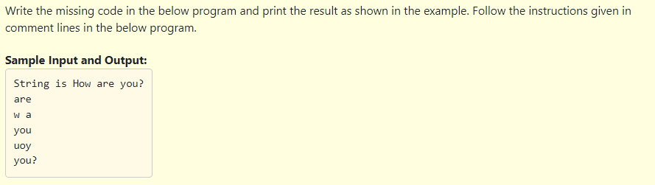
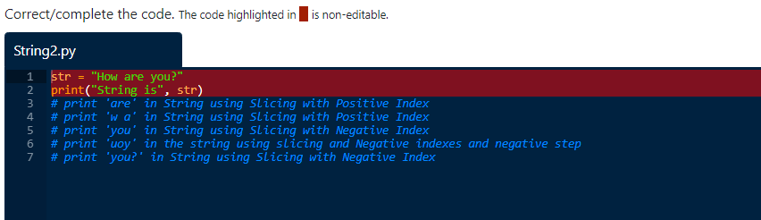

Slide 11
str = "How are you?"
print("String is", str)
print(str[4:7])
print(str[2:5])
print(str[-4:-1])
print(str[-2:-5:-1])
print(str[-4:])

Slide 12
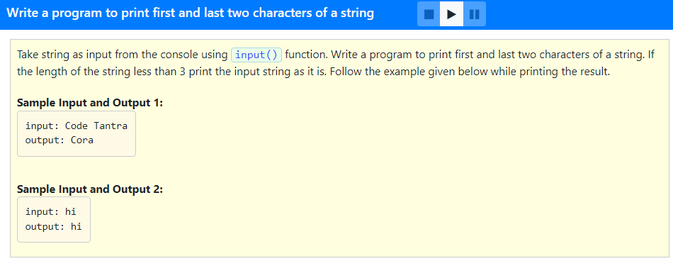

Slide 13
#Program to print first two and alst two characters of string if length is >2
str = input("input: ")
if len(str) > 2:
print("output:", str[:2] + str[-2:])
else:
print("output:", str)

Slide 14
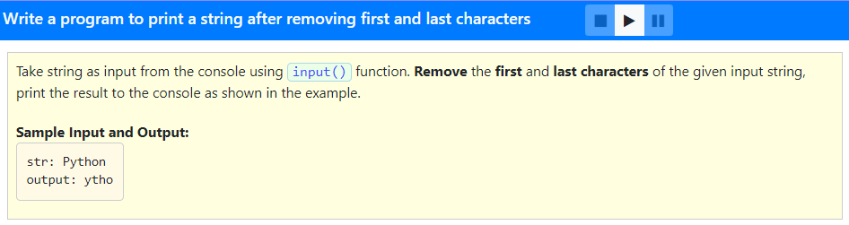

Slide 15
#Program to print a given string omitting the first and last character
str = input("str: ")
print("output:", str[1:-1])

Slide 16
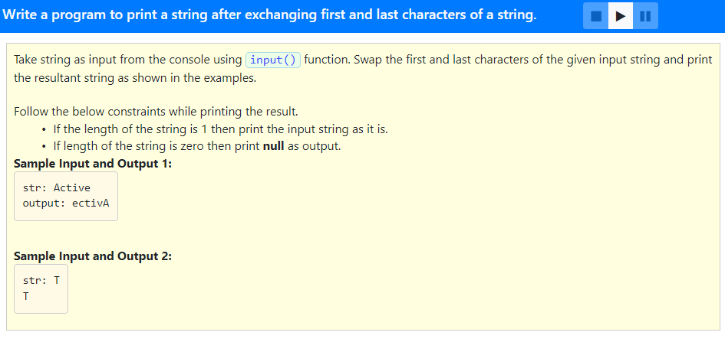

Slide 17
#Program to exchange first and last characters of a string
str = input("str: ")
if len(str) > 1:
print("output:", str[-1] + str[1:-1] + str[0])
else:
if len(str) == 1:
print(str)
else:
print ("null")

Slide 18
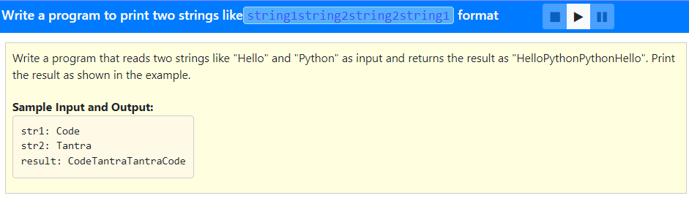

Slide 19
#Program to illustrate Concatenation of two strings
str1 = input("str1: ")
str2 = input("str2: ")
print("result:", str1 + str2 + str2 + str1)

Slide 20
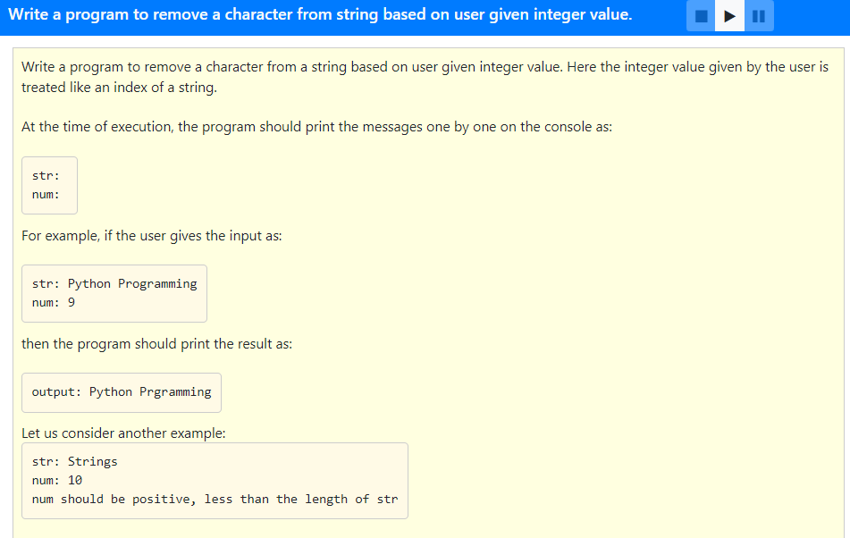

Slide 21
#Program to remove a character at a given position from a given string
str = input("str: ")
num = int(input("num: "))
if num > len(str) or num < 0:
print("num should be positive, less than the length of str")
else:
print("output:", str[:num] + str[num + 1:])

Slide 22
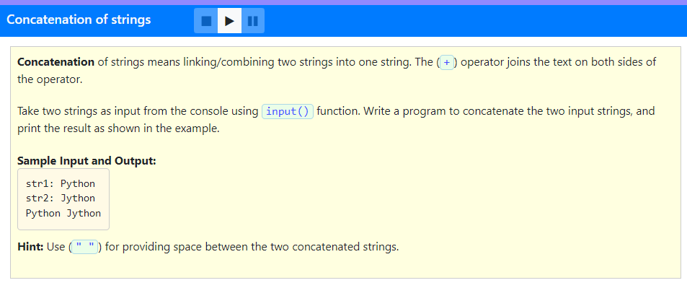

Slide 23
str1 = input("str1: ")
str2 = input("str2: ")
print(str1 + " " + str2)

Slide 24
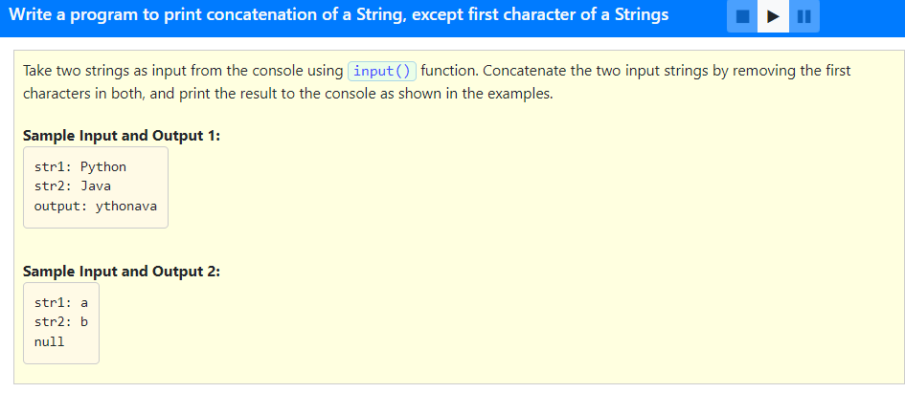

Slide 25
#Program to print the concatenation of two strings except for the first character
str1 = input("str1: ")
str2 = input("str2: ")
str3 = str1[1:] + str2[1:]
if len(str3) == 0:
print("null")
else:
print("output:", str3)

Slide 26
Using membership (in, not in) operators check if a particular sub-string (or character) is in the string or not.
Returns True if required sub-string (character) is present in string otherwise returns False.
Example
s = "good morning"
print("m" in s) # here we are checking 'm' character is present in s string or not
Output: True # 'm' character existed in s string so returns True
print("a" not in s) # here we use logical operator not
Output: True
print("z" in s) # will print the result as follows
Output: False #'z' is not in s, so it returns False.
print("good" in s) # will print the result as follows
Output: True #'good' is in s so it returns True as output.
print("Morning" in s) # will print the result as follows
Output: False # Here "Morning" is not in s because m starts with capital letter. Python is Case-Sensitive.

Slide 27
Which of the following option is correct?
str = "Coding",
1. r in str, returns True
2. 's' in str, returns True
'z' not in str, returns True
1 and 2
1 and 3
Only 3
Only 1

Slide 28
Which of the following option is correct?
str = "Coding",
1. r in str, returns True
2. 's' in str, returns True
'z' not in str, returns True
1 and 2
1 and 3
Only 3
Only 1

Slide 29
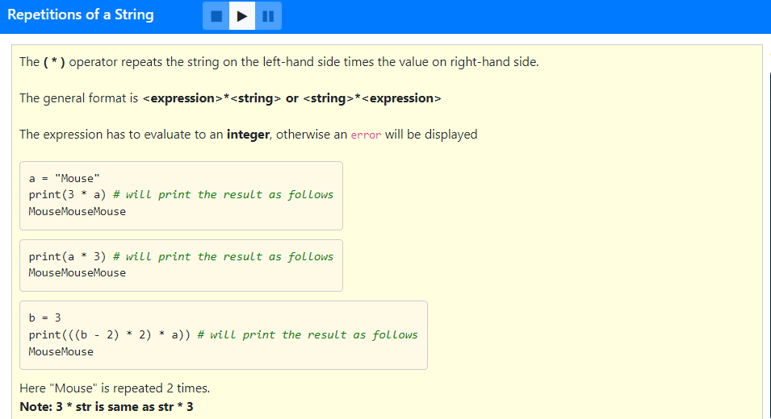

Slide 30
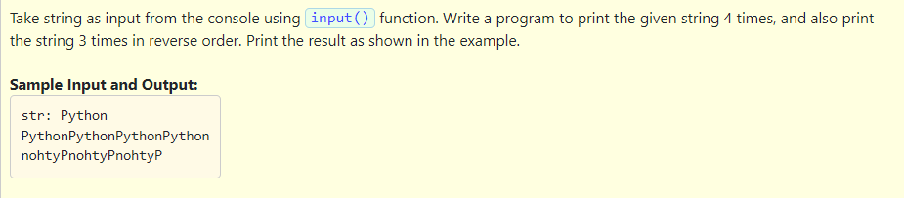

Slide 31
Solution:
#Program to illustrte * operator for strings
str = input("str: ")
print (str * 4)
print (3 * str[:: - 1])

Slide 32
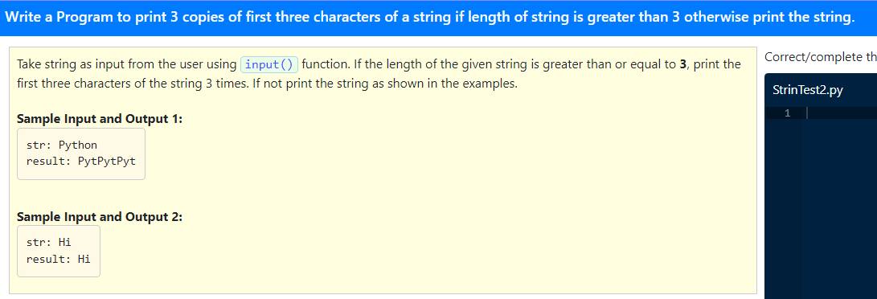

Slide 33
Solution:
#Program to illustrate * operator and slicing
str = input("str: ")
if len(str) >= 3:
print("result:", 3 * str[:3])
else:
print("result:", str)

Slide 34
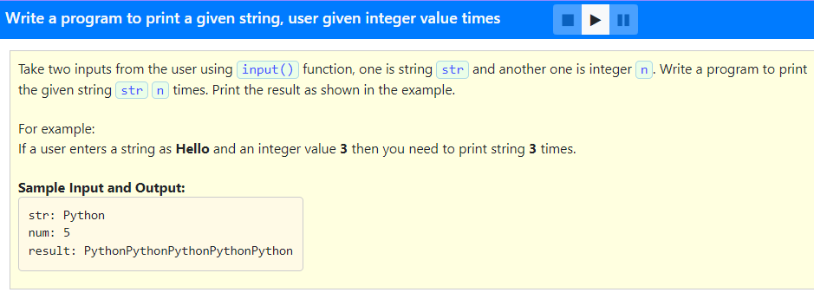

Slide 35
#Program to print the given string given number of streams
str = input("str: ")
num = int(input("num: "))
print("result:", num * str)

Slide 36
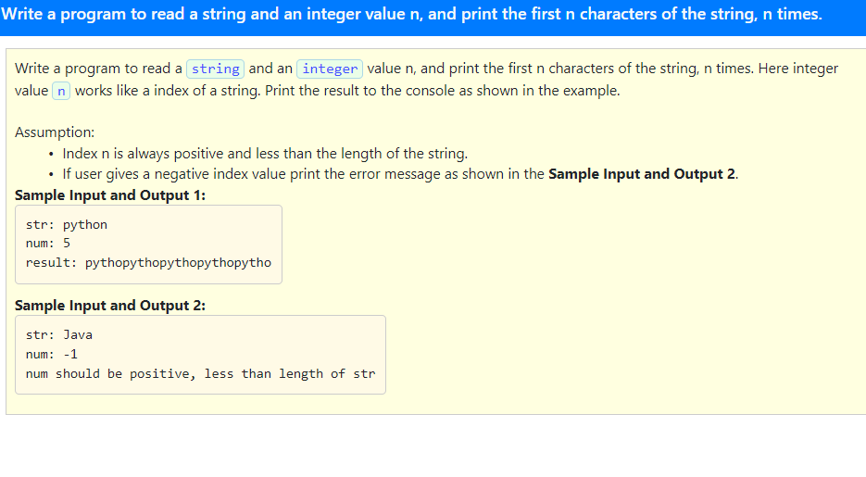

Slide 37
#Program to repeat first n chracters of the given string n times
str = input("str: ")
num = int(input("num: "))
if num > len(str) or num < 0:
print("num should be positive, less than length of str")
else:
print("result:", num * str[:num])

Slide 38
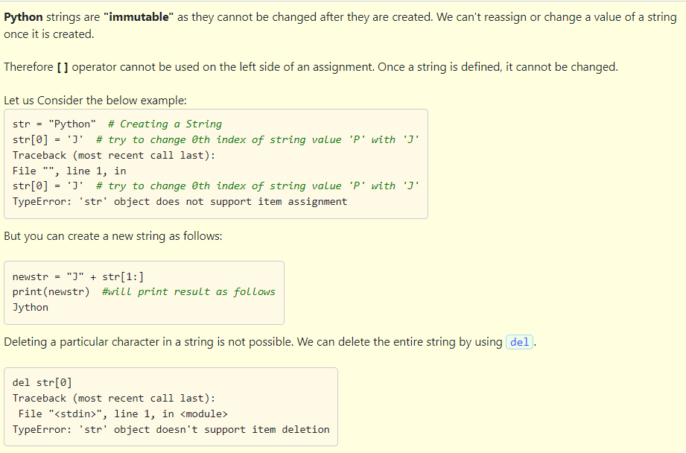

Slide 39
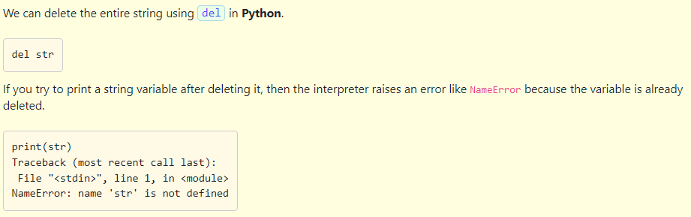

Slide 40
Which of the following is the correct option?
1. Strings are Immutable (we can't assign or change the value)
2. We can perform deletion of part of a String using delete().
3. Deletion of individual characters of a string is possible based on index.
1 and 2
2 and 3
3 only
1 only

Slide 41
Which of the following is the correct option?
1. Strings are Immutable (we can't assign or change the value)
2. We can perform deletion of part of a String using delete().
3. Deletion of individual characters of a string is possible based on index.
1 and 2
2 and 3
3 only
1 only

Slide 42
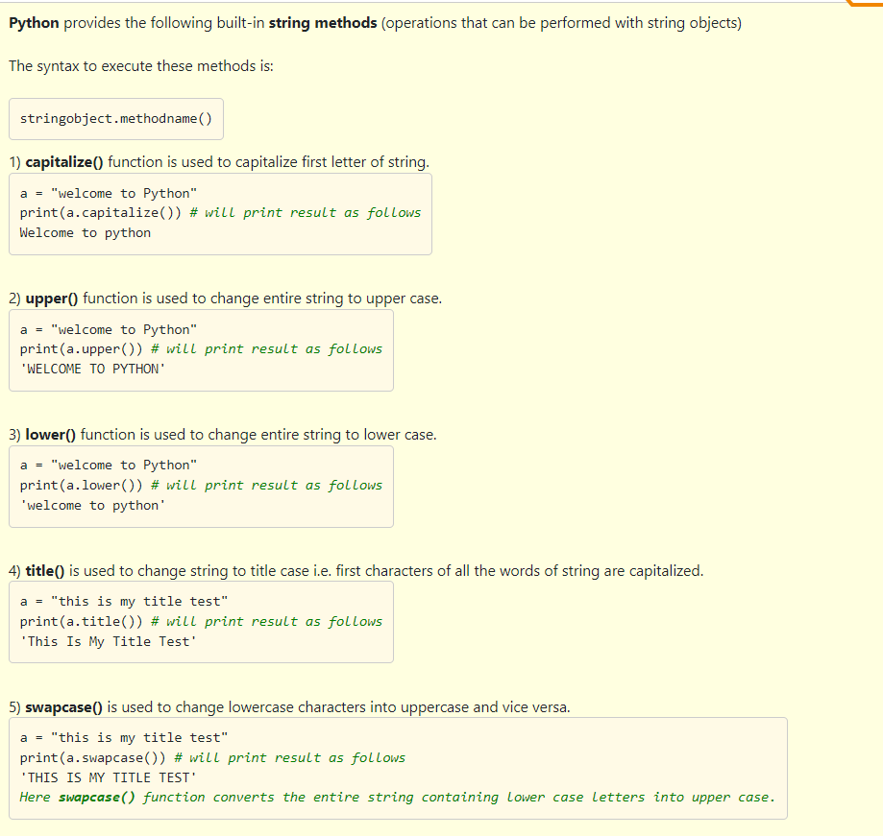

Slide 43
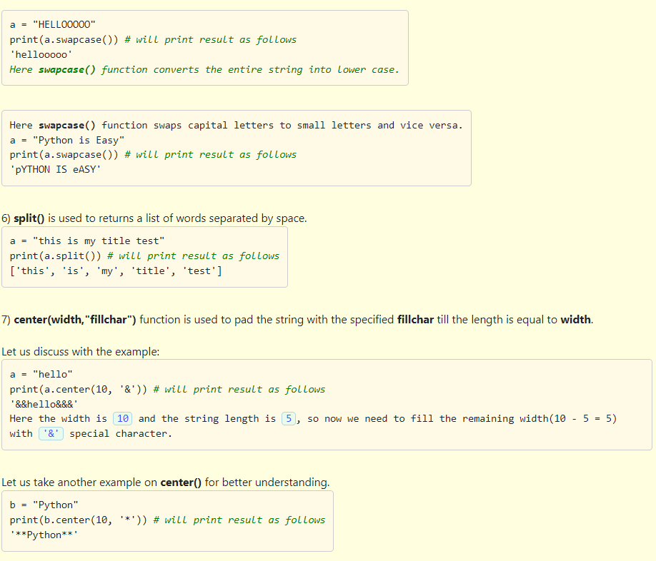

Slide 44
Which of the following option is correct?
1. In Python, we can convert strings of Uppercase letters into lower case and lower case to upper case using swapcase() method.
2. print('python is simple'.title()) gives output like Python Is Simple.
3. a = "python is my favourite" a[3] = 'l' , replaces 'l' with 'h'.
4. a = "python" + 3.7 returns output as python3.7.
5. print('abcpyxyzpython', 3, 10) gives output as error.
6. print('20.3'.isnumeric()) it returns output as False.
1,2,3,4
2,5,6
1,2,6
5,6

Slide 45
Which of the following option is correct?
1. In Python, we can convert strings of Uppercase letters into lower case and lower case to upper case using swapcase() method.
2. print('python is simple'.title()) gives output like Python Is Simple.
3. a = "python is my favourite" a[3] = 'l' , replaces 'l' with 'h'.
4. a = "python" + 3.7 returns output as python3.7.
5. print('abcpyxyzpython', 3, 10) gives output as error.
6. print('20.3'.isnumeric()) it returns output as False.
1,2,3,4
2,5,6
1,2,6
5,6

Slide 46
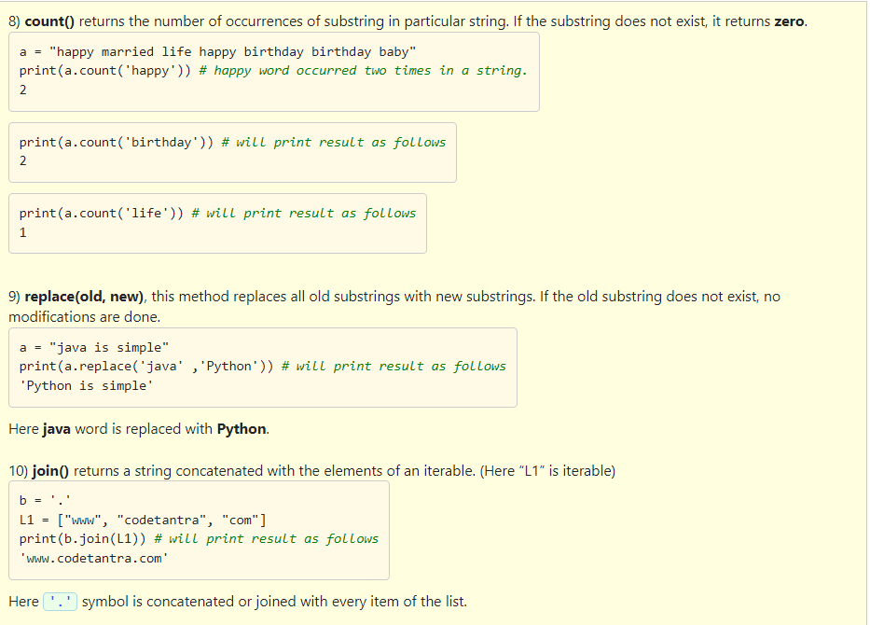

Slide 47
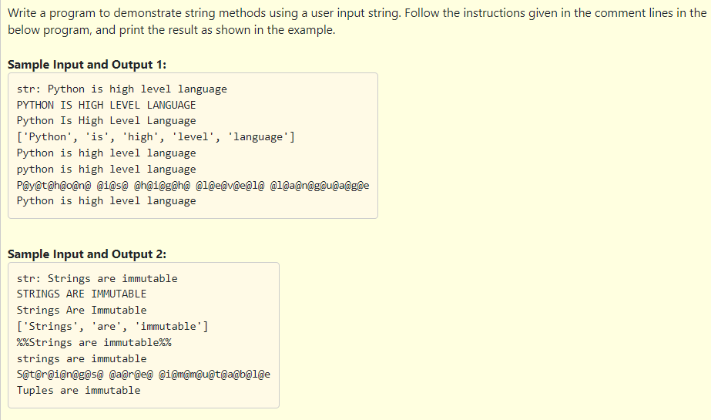

Slide 48
Solution:
str1 = input("str: ")
print(str1.upper())
print(str1.title())
print(str1.split())
print(str1.center(25, '%'))
print(str1.lower())
str2 = '@'
print(str2.join(str1))
print(str1.replace('Strings', 'Tuples'))

Slide 49
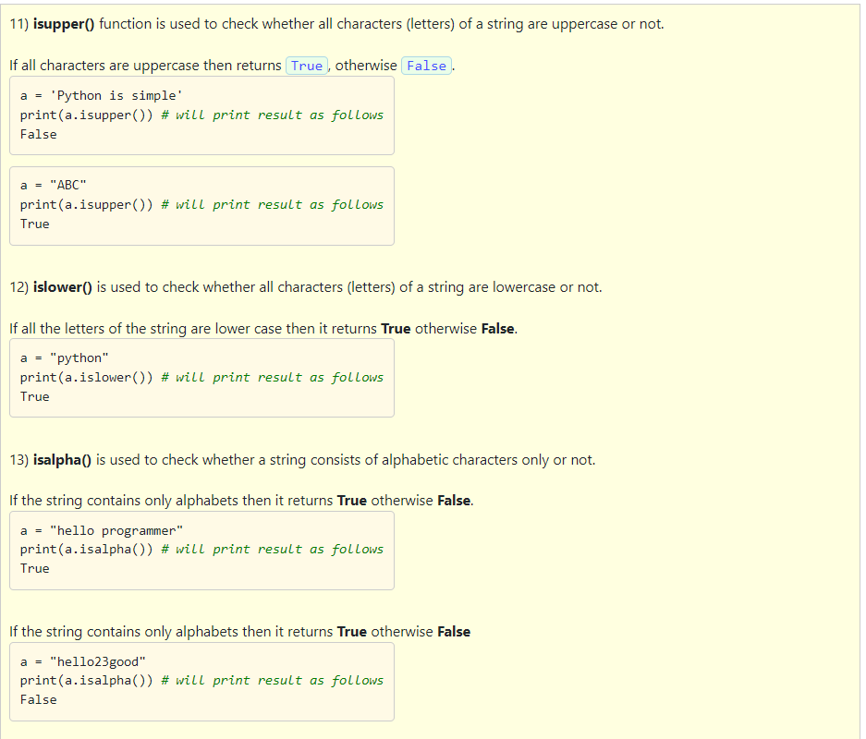
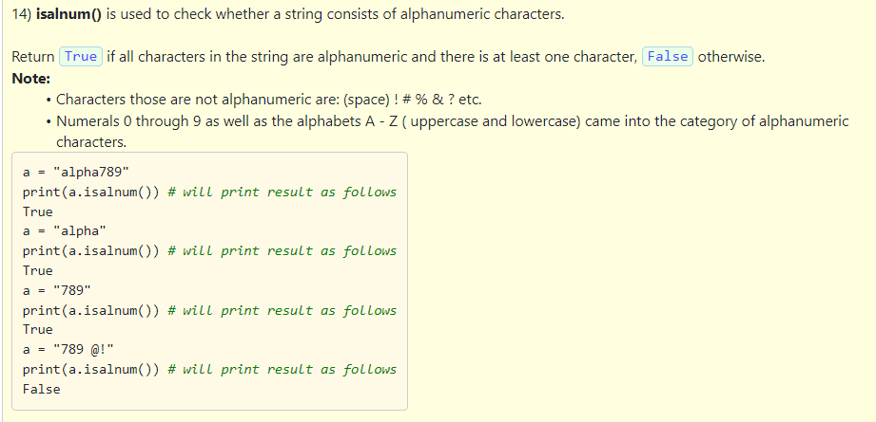

Slide 50
Select the correct options
1. str = "PYTHOn" print(str.isupper()) returns output as True.
2. print("\nhello") prints the output hello on a new line.
3. str = '123', the below code is correct to convert string into int. print(int(str)) # 123.
4. str = "hello world", print(str.isalnum()) returns False.
1 and 2
2,3 and 4
3 and 4
2 and 4

Slide 51
Select the correct options
1. str = "PYTHOn" print(str.isupper()) returns output as True.
2. print("\nhello") prints the output hello on a new line.
3. str = '123', the below code is correct to convert string into int. print(int(str)) # 123.
4. str = "hello world", print(str.isalnum()) returns False.
1 and 2
2,3 and 4
3 and 4
2 and 4

Slide 52
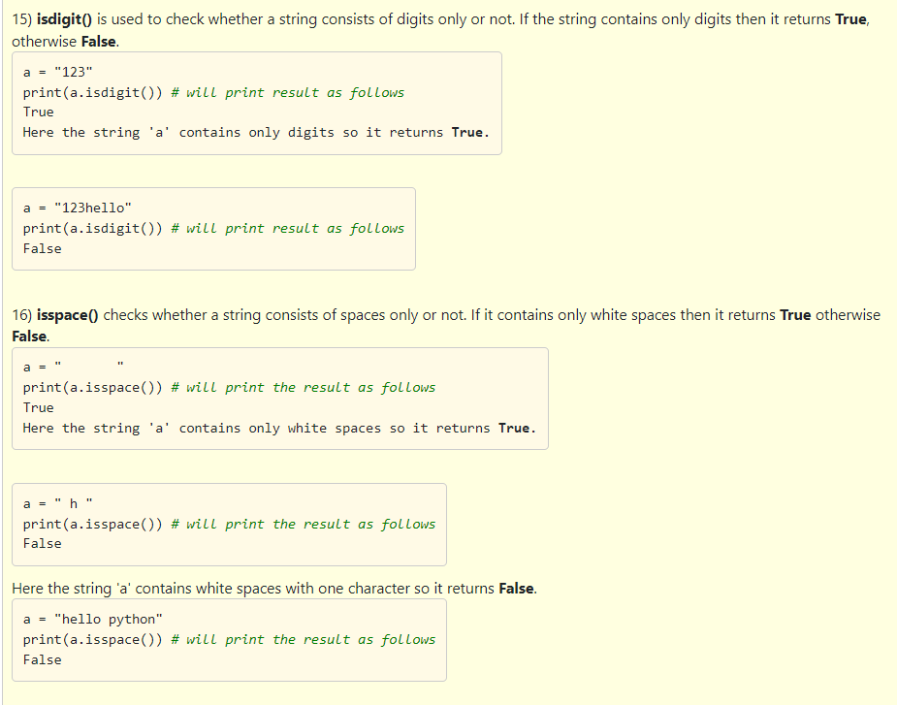

Slide 53
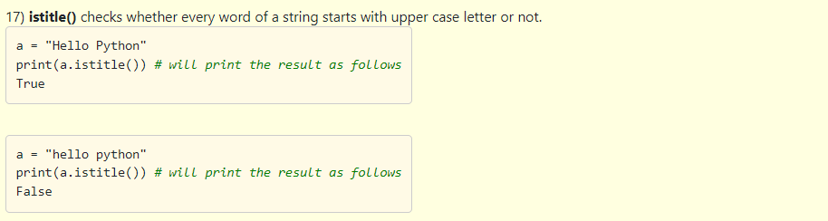

Slide 54
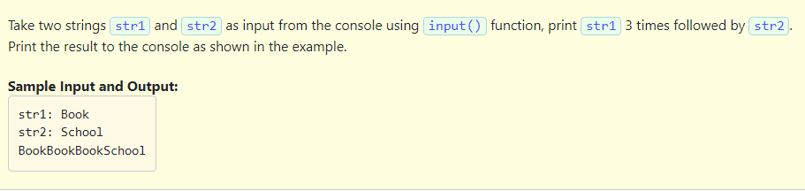

Slide 55
Solution:
str1 = input("str1: ")
str2 = input("str2: ")
print(3 * str1 + str2)

Slide 56
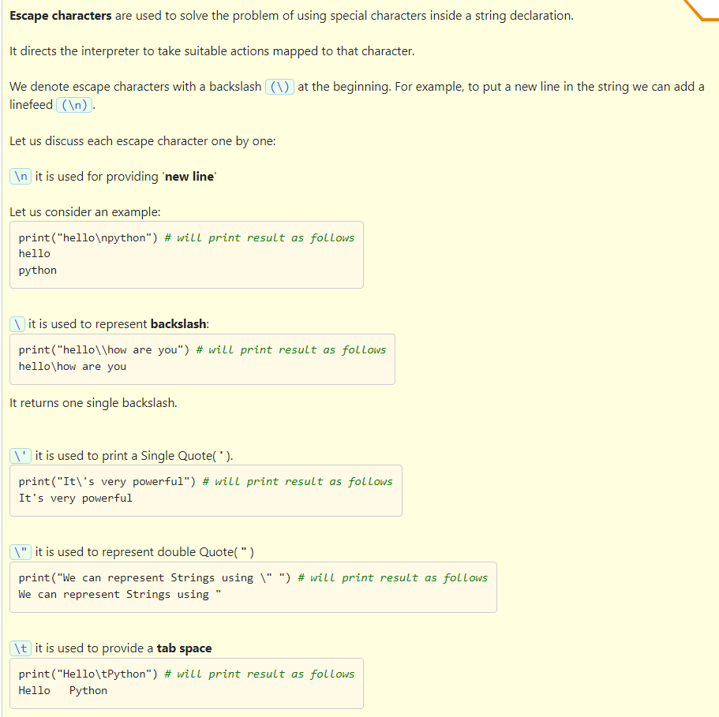

Slide 57
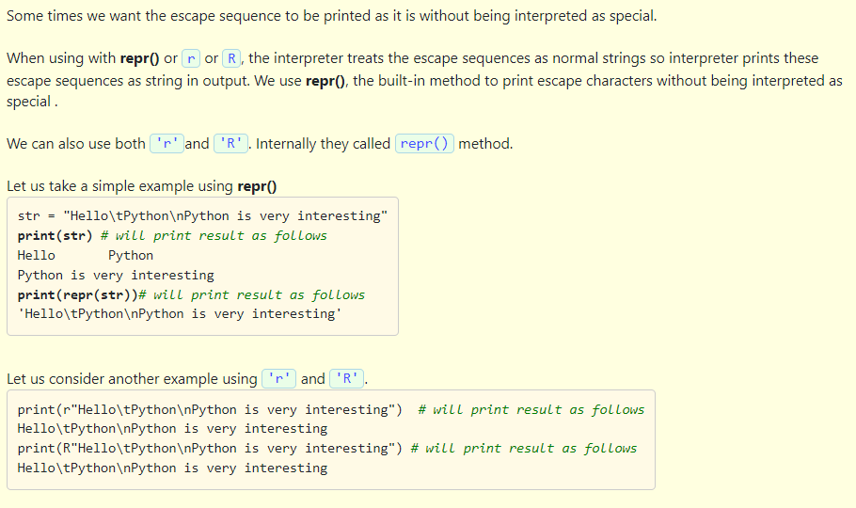

Slide 58
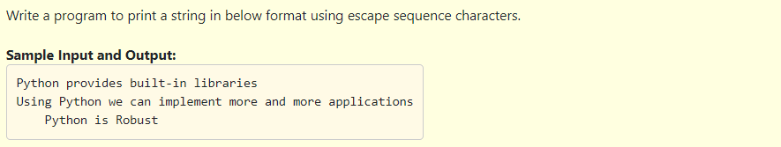

Slide 59
Solution:
#Program to illustrate usage of special characters
print("Python provides built-in libraries\nUsing Python we can implement more and more applications\n\tPython is Robust")

Slide 60
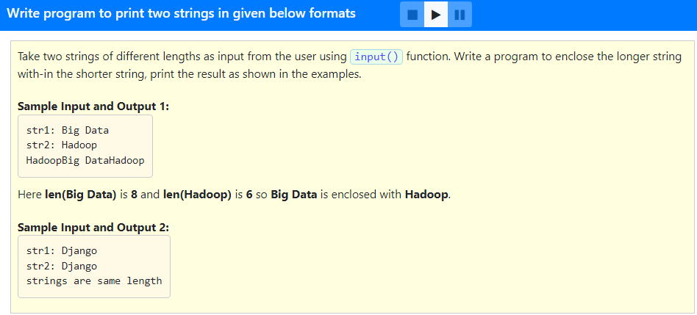

Slide 61
#Program to enclose longer length string within shorter length string
str1 = input("str1: ")
str2 = input("str2: ")
l1 = len(str1)
l2 = len(str2)
if l1 == l2:
print("strings are same length")
elif l1 < l2:
print(str1 + str2 + str1)
else:
print(str2 + str1 + str2)

Slide 62
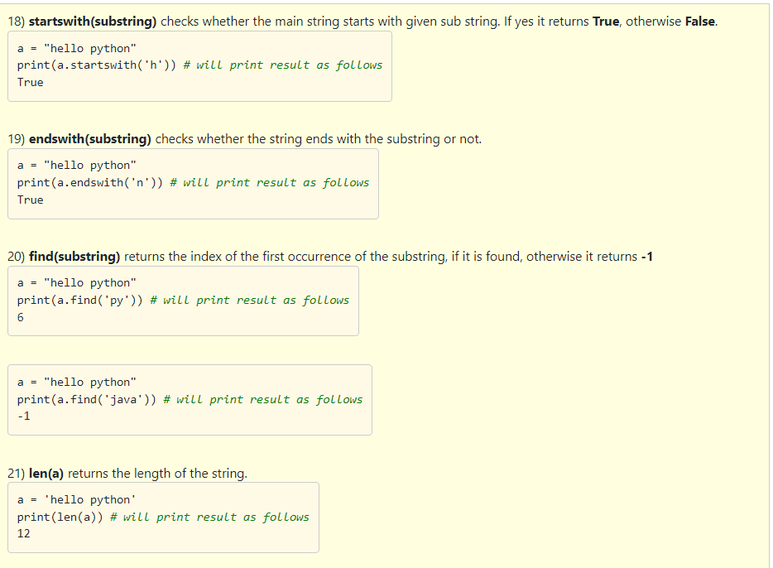

Slide 63
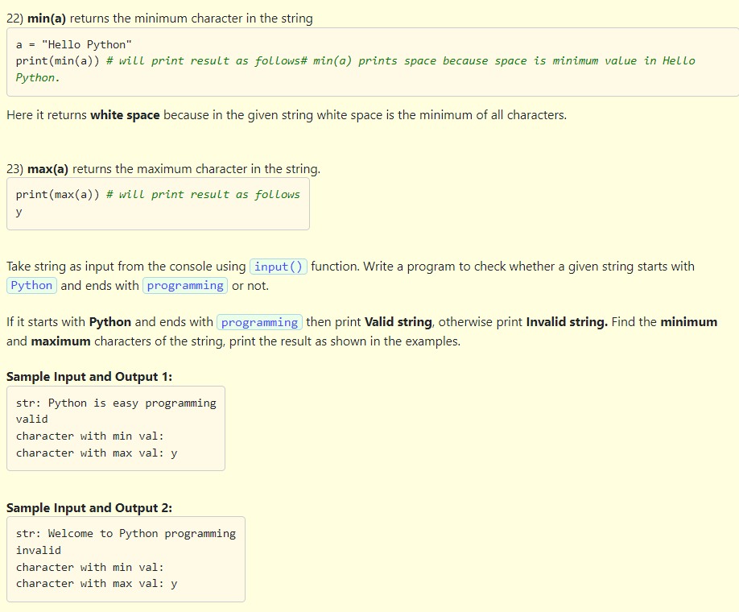

Slide 64
#Program to illustrate startswith and endswith methods
#print("This program checks whether the given string starts with 'Python' and ends with 'programming'")
str = input("str: ")
if (str.startswith('Python') and str.endswith('programming')):
print("valid")
else:
print("invalid")
print("character with min val:", min(str))
print("character with max val:", max(str))

Slide 65
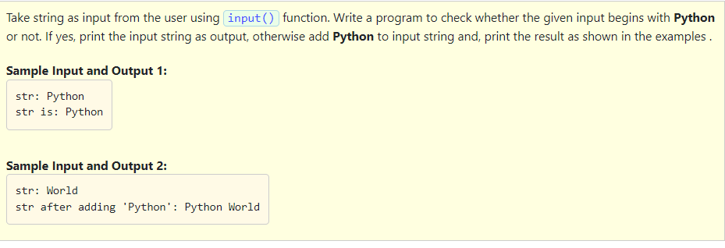

Slide 66
#Progran to illustrate startswith method of string
str = input("str: ")
if str.startswith("Python"):
print("str is:", str)
else:
str = "Python" + " "+ str
print("str after adding 'Python':", str)

Slide 67
A module is a file containing Python definitions, functions and statements.
Standard library of Python is extended as modules.
To use these modules in a program, the programmer needs to import the modules.
Once we import a module, we can refer to or use any of its functions or variables defined in the module of our code.
There are a large number of standard modules available in Python.

Slide 68
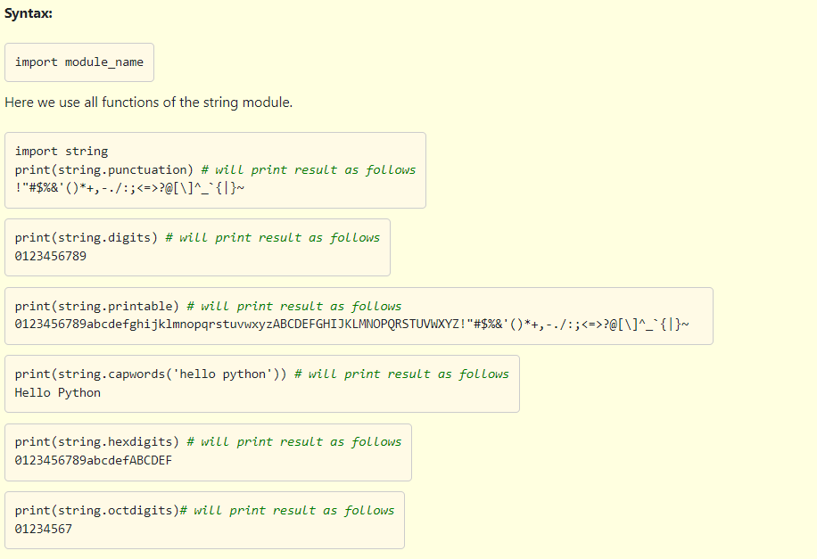

Slide 69
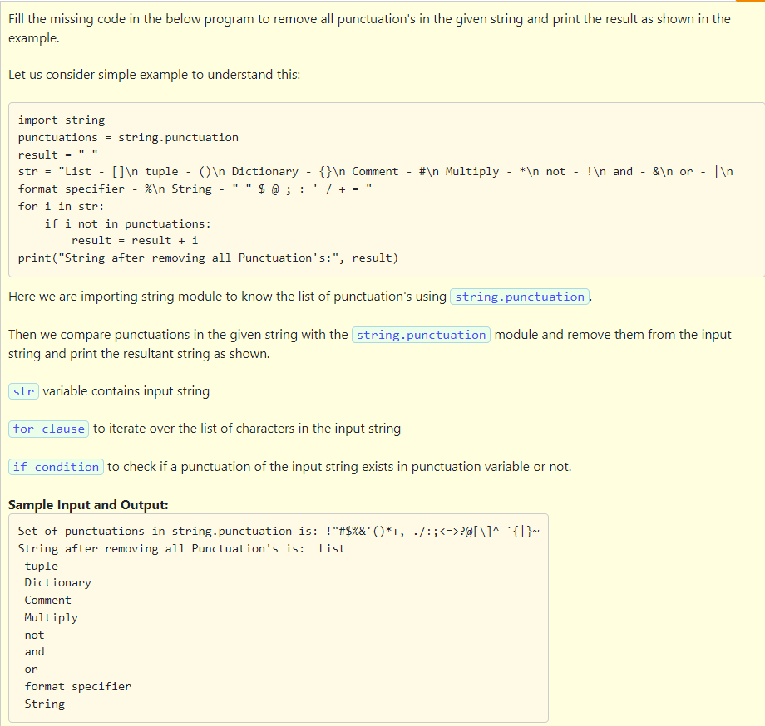

Slide 70
Solution:
#Program to remove punctuation marks from a string
import string
punctuations = string.punctuation
result = " "
str = "List - []\n tuple - ()\n Dictionary - {}\n Comment - #\n Multiply - *\n not - !\n and - &\n or - |\n format specifier - %\n String - " " $ @ ; : ' / + = "
for i in str:
if i not in punctuations:
result = result + i
print("Set of punctuations in string.punctuation is:", punctuations)
print("String after removing all Punctuation's is:", result)

Slide 71
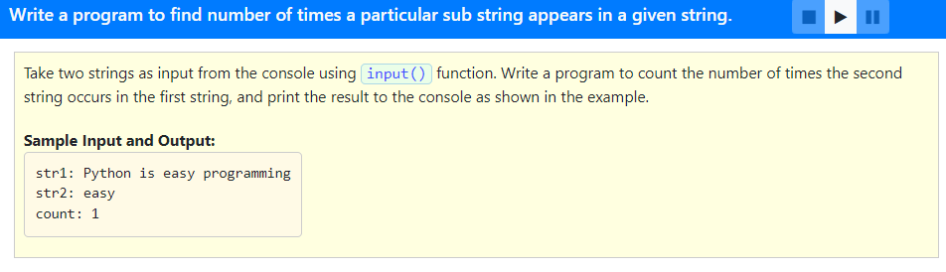

Slide 72
#Program to find the number of times a substring appears in a given string
str = input("str1: " )
sstr = input("str2: ")
print("count:", str.count(sstr))

Slide 73
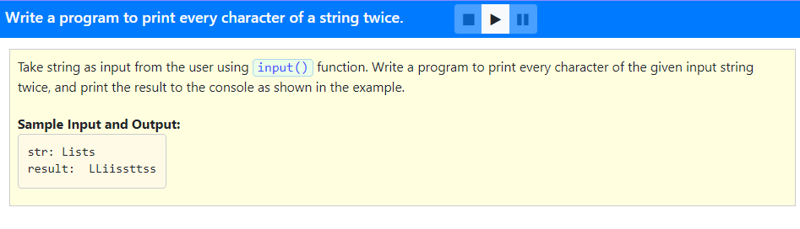

Slide 74
#Program to reproduce a string with repetition of each character
str = input("str: ")
result = " "
for i in str:
result = result + 2 * i
print("result:", result)

Slide 75
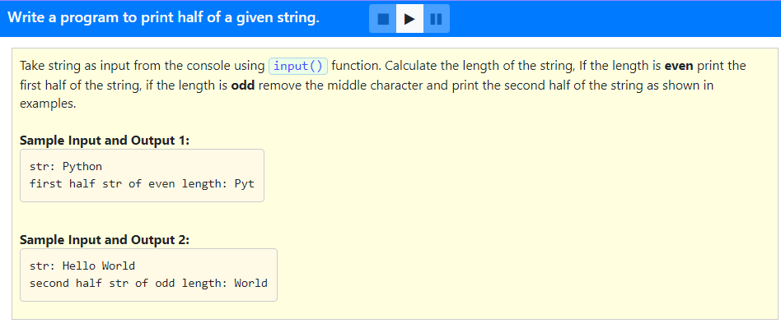

Slide 76
#Program to print the first or second half of the string depending on the length
str = input("str: ")
length = len(str)
if length % 2== 0:
print("first half str of even length:", str[:len(str) // 2])
else:
print("second half str of odd length:", str[length // 2 + 1:])

Slide 77
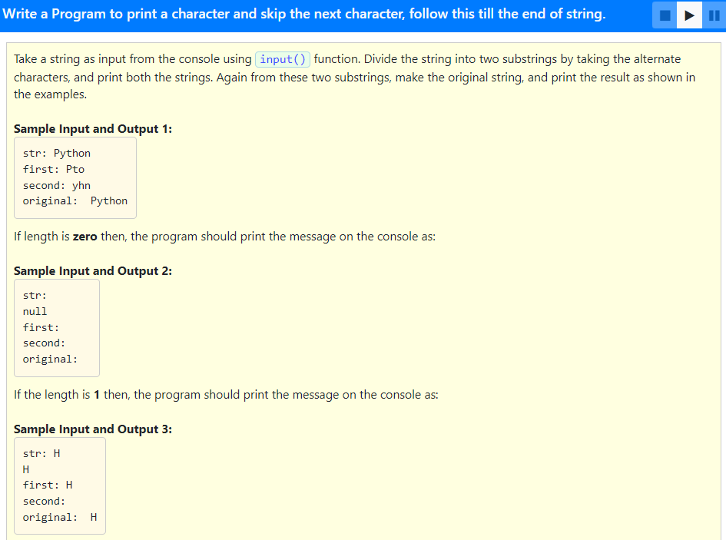

Slide 78
Solution:
str = input("str: ")
fstr = ""
sstr = ""
if len(str) == 0:
print("null")
else:
if len(str) == 1:
print(str)
for i in range(0,len(str)):
if i % 2 == 0:
fstr = fstr + str[i]
else:
sstr = sstr + str[i]
print("first:", fstr)
print("second:", sstr)
print("original:",str)

Slide 79
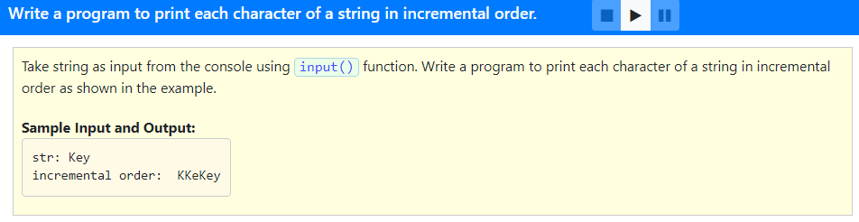

Slide 80
#Program to print the given string in incremental order
str = input("str: ")
length = len(str)
result = ""
for s in range(0, length+1):
result = result + str[:s]
print("incremental order:", result)

Slide 81
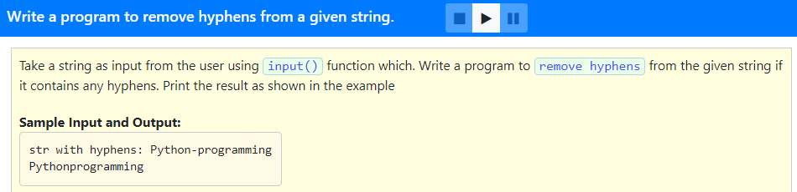

Slide 82
#Program to remove hyphens
str = input("str with hyphens: ")
for i in str.split('-'):
print(i, end = '')

Slide 83
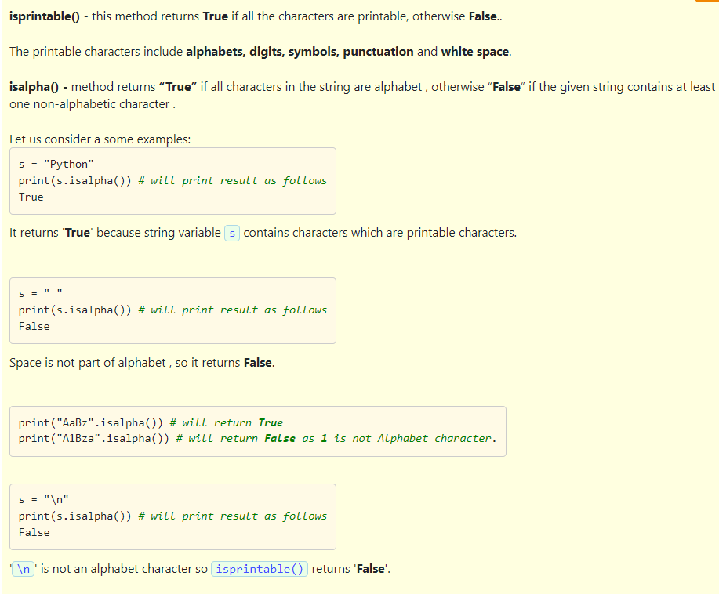

Slide 84
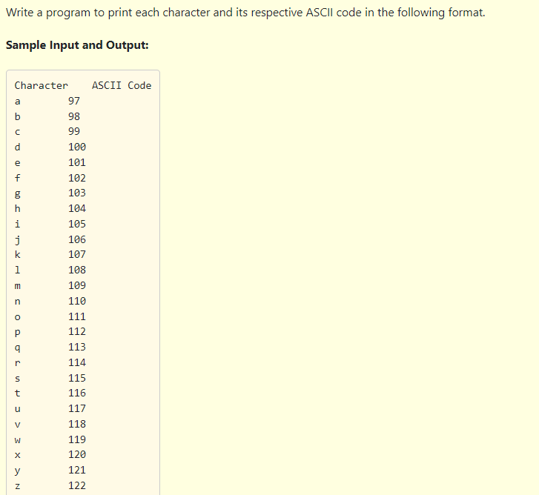
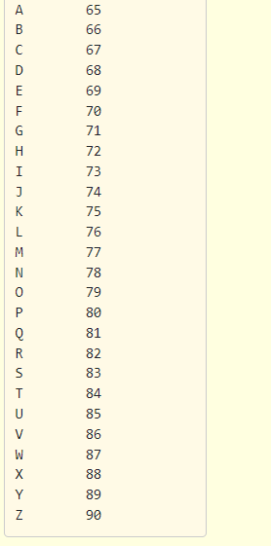

Slide 85
Solution:
#Program to print a table of printable charcters and their ASCII values
import string
print("Character\t ASCII Code")
for x in string.ascii_letters:
print (x, "\t\t", ord(x))

Slide 86
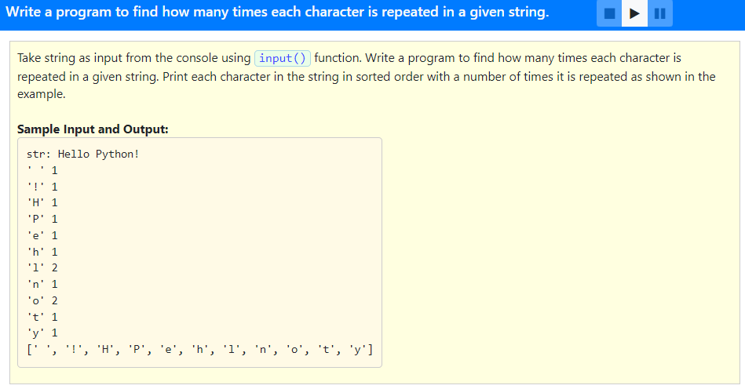

Slide 87
str1 = input("str: ")# Get the Input string
str3 = sorted(str1) # Sort the string
printed = [] # Blank List
for char in str3: # For each character in the input
if char not in printed: # check whether printed or not
print("'{0}'\t{1}".format(char, str3.count(char))) # print char and count
printed.append(char) # add to printed list
print(printed)

Slide 88


Slide 89
str1 = (input("str: "))
printed = []
for y in str1:
if(y not in printed):
print(y,"\t", str1.count(y))
printed.append(y)

